Slide 1

Product Success Prediction
PMI - Case study 2
Bernardo Fernandes

Slide 2
Summary
1. Planning
2. Data
2.1 Data Understanding
2.2 Data Preparation
2.3 Feature engineering & Sampling
3. Modeling
3.1 Model Training
3.2 Model Results
4. Predictions
4.1 Prediction trends
5. Next steps

Slide 3
Problem Understanding
Objective
A model to identify which product will be successful or not .
Business goals
Benefits/Who will use
Less cost, decreasing the rate of unsuccessful products yearly
More revenue, investing where there are higher chances of success

Slide 4
Planning
Jupyter notebook in GitHub
Data Exploration
Variable distributions
Data Preparation
Predictive Modeling
Classification & regression
Interpret Results
Feature engineering
EDA
Data pipeline
Feature importance
Predictions
Train/test splitting
Balancing
Missing values identification
Train/test performance
Model tuning
Trends
Cardinality

Slide 5
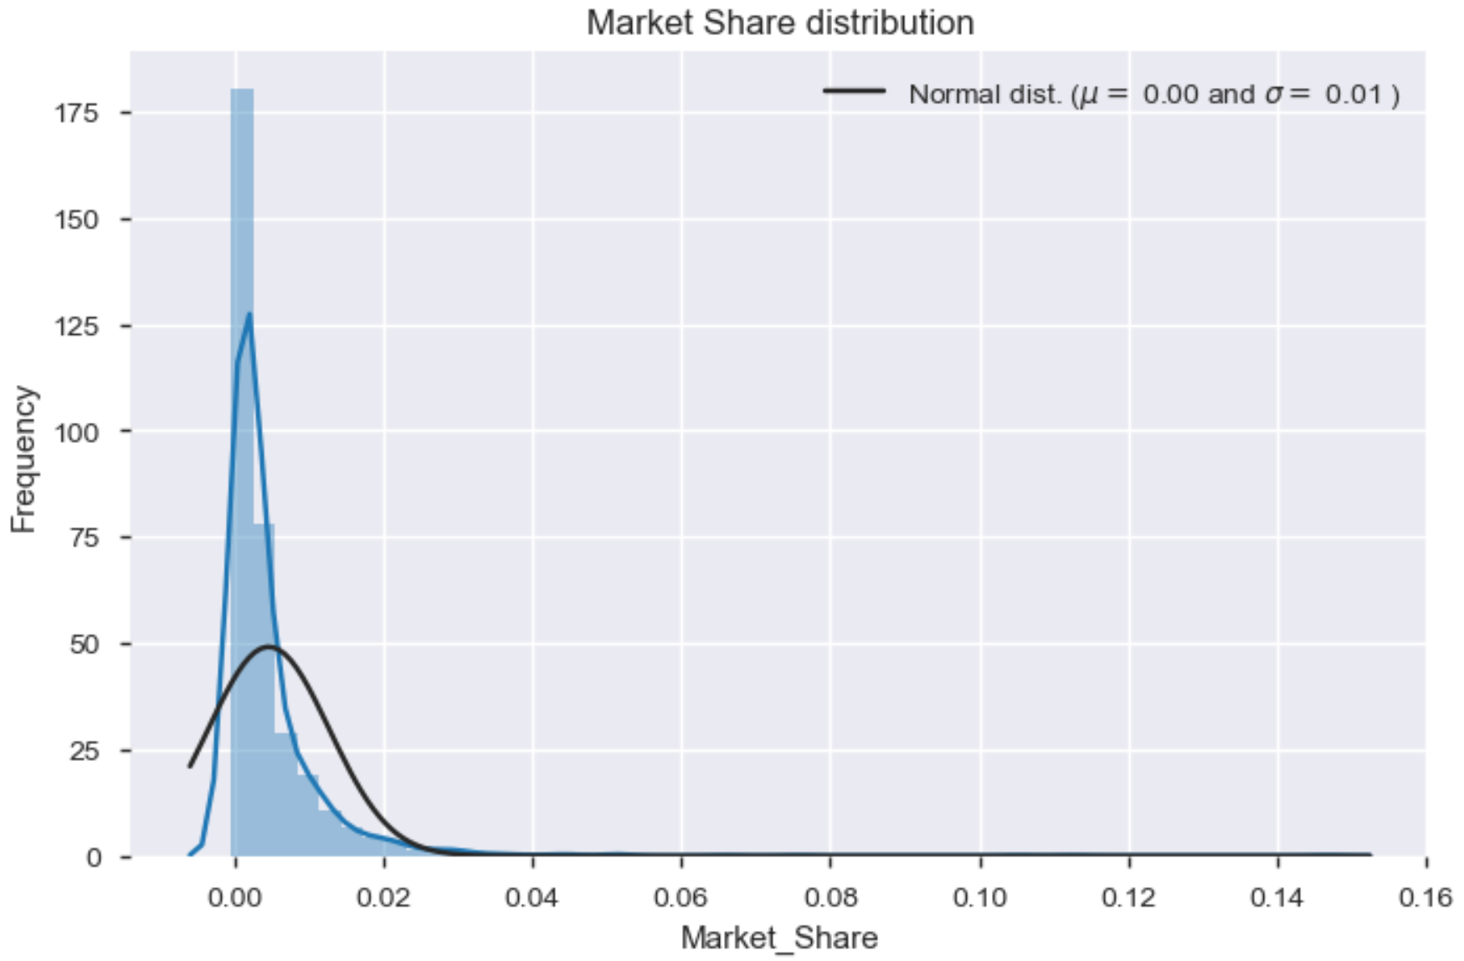
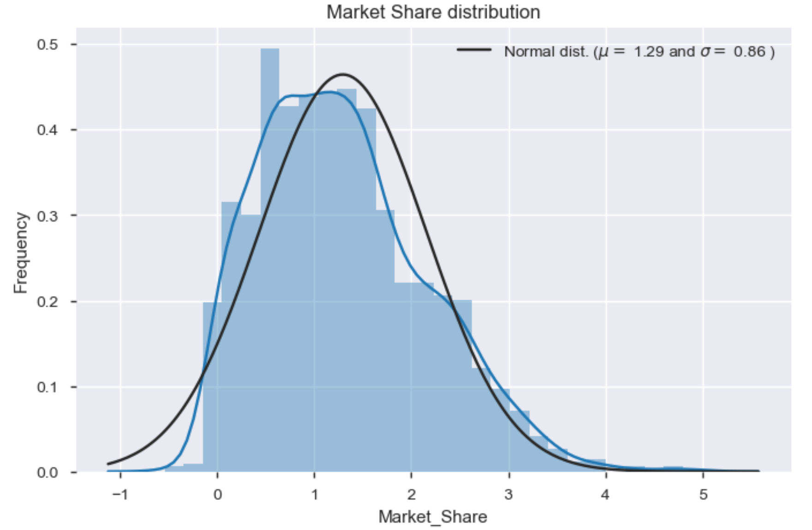
Data Understanding
Labeled dataset: 1716 rows, 40 columns
Blind dataset: 29 rows, 39 columns
Column types: 34 categorical, 5 numerical
Target variable:
Regression: Market_Share (log tranformed)
Classification: is_successful 0.7% (329 successful, 1387 unsuccessful)
Prediction dataset:
Has multiple launch years. It contains observations from previous years
It is not like predicting the future, which would need a time series of some sort
(Log transformed)

Slide 6
Data Trends
Other plots

Slide 7
Feature engineering & Sampling
Transform categorical variables with one hot encoding
REGION, MARKET, BRANDDIFFERENTIATOR, BRANDFAMILY, BRANDSUBFAMILY, BRANDSUBFAMILYGROUP, BRANDSUBFAMILYGROUPING, BRANDSUBFAMILYLINE, CHARINDICATOR, INDICATOR, INTERNATIONALINDICATOR, ISSTRATEGIC, ITEMSCODE, LENCATEGORY, PRICECLASS, LOCALCLASS, MINDICATOR, PCKT, PRICECLASSON, TCLASS, THICATEGORY, TRACKINGSTATUS
Detect correlated features
None in original numerical variables, many in the one hot encoded
BRANDSUBFAMILY , BRANDSUBFAMILYGROUPING
Train test split
80% train, 20% test
Stratified on target class variable (20% successful)
Balanced train dataset (undersampled)
263 successful (50%)
263 unsuccessful (50%)
Test dataset size
66 successful (~20%)
278 unsuccesful (~80%)
Each model gets a dataset with suitable preparations according to its needs
Algorithm | Estimator | Undersampling | One Hot Encoding | Samples | Features
CatBoost | Regressor | N | N | 1372 | 28
CatBoost | Classifier | Y | N | 526 | 28
XGBoost | Regressor | N | Y | 1372 | 265
XGBoost | Classifier | Y | Y | 526 | 265

Slide 8
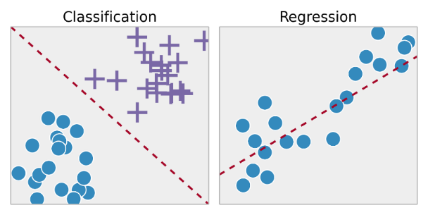


Model Training
Will a product be successful?
Yes/No
XGBoost Regressor
XGBoost Classifier
Grid search
GPU training
CatBoost Regressor
CatBoost Classifier
Doesn’t require categorical features transformation
GPU training
Framing the problem as both regression and classification allows to understand two different perspectives
Comparison https://towardsdatascience.com/catboost-vs-light-gbm-vs-xgboost-5f93620723db

Slide 9
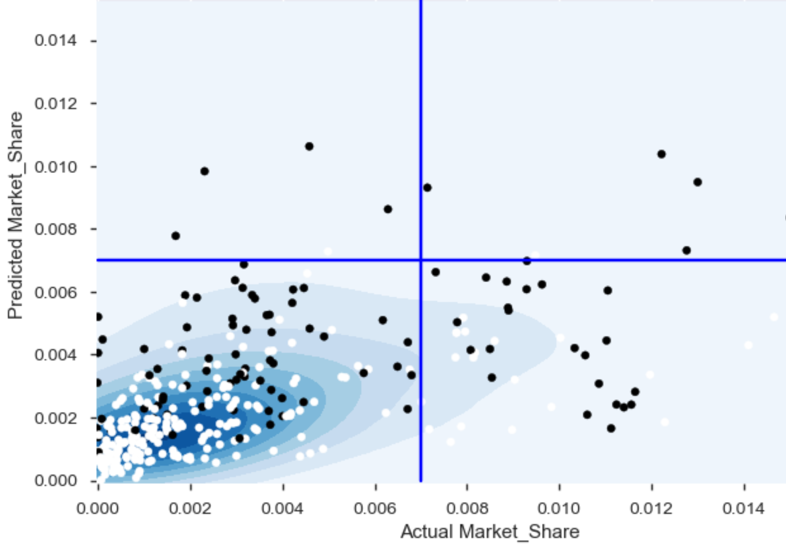
Model Results
CatBoost Actual Market Share vs Predicted Market Share
(Best model test results)
Classification models
Regression models
Feature importance
Model | Accuracy | F1 | AUC
CatBoost | 71% | 0.46 | 0.68
XGBoost | 63% | 0.38 | 0.62
0.7%
Model | MSE | R2
CatBoost | 0.0026 | 0.15
XGBoost | 0.0029 | 0.08
CatBoost displayed better performance in the test set in both approaches and was selected as the best model
Black dots are positive classifications and white are negative
The darker areas means that region is denser with a lot of test samples
Error in the predicted Market share are concentered in a small range (0-0.004)
CatBoost | XGBoost
Market | Retail Pack Price
Indicator | Ncon
Price Class | Launch Year
Packet | Trconte
Notes:
Explain model confidence, for regression it can be 0.007 +- 0.002, classification the probability of each prediction

Slide 10
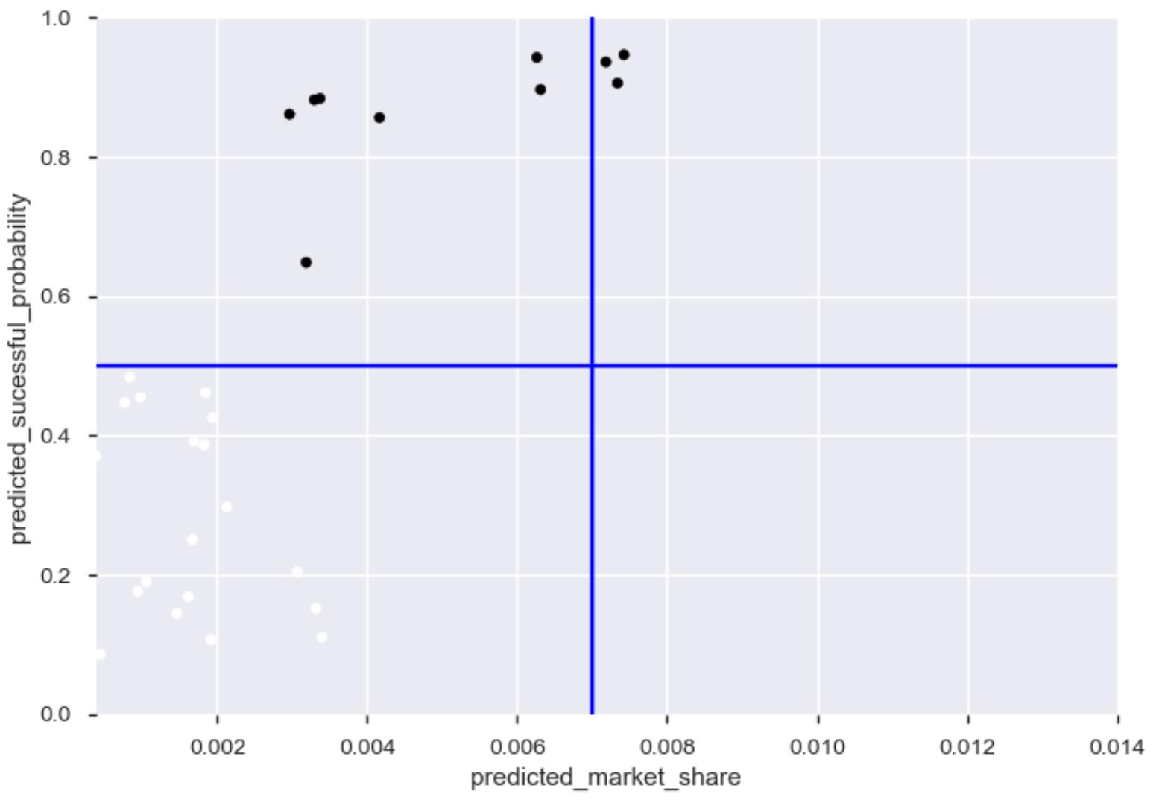
Predictions
Predicted market share (regression) vs Predicted Probability (Classification)
BRMID | Market | Retail Pack Price | Packet | Price Class | Predicted Market Share | Predicted Succesful | Successful Probability
60078078 | MARKET89 | 10 | PCKT24 | PRICECLASS16 | 0.72% | Yes | 93.6%
60080398 | MARKET30 | 1.55 | PCKT11 | PRICECLASS16 | 0.73% | Yes | 90.6%
60071997 | MARKET30 | 2 | PCKT11 | PRICECLASS1 | 0.74% | Yes | 94.6%
2
1
.
.
29 products scored
Quadrant 1: 3 predicted successful products that both models agree
Quadrant 3: 19 products are predicted to be unsuccessful
Quadrant 2: 7 products predicted with over 50% probability but not enough predicted market share
.
.
Successful Probability
.
.
.
.
3
4
.
.
.
.
.
.
.
.
.
.
.
Predicted Market Share

Slide 11
Predictions
Predicted market share (regression) vs Predicted Probability (Classification)
BRMID | Market | Retail Pack Price | Packet | Price Class | Predicted Market Share | Predicted Succesful | Successful Probability
60078078 | MARKET89 | 10 | PCKT24 | PRICECLASS16 | 0.72% | Yes | 93.6%
60080398 | MARKET30 | 1.55 | PCKT11 | PRICECLASS16 | 0.73% | Yes | 90.6%
60071997 | MARKET30 | 2 | PCKT11 | PRICECLASS1 | 0.74% | Yes | 94.6%
2
1
.
.
29 products scored
Quadrant 1: 3 predicted successful products that both models agree
Quadrant 3: 19 products are predicted to be unsuccessful
Quadrant 2: 7 products predicted with over 50% probability but not enough predicted market share
.
.
Successful Probability
.
.
.
.
3
4
.
.
.
.
.
.
.
.
.
.
.
Predicted Market Share
Recommendation: Both models agrees that 3 products have the greatest chances of being successful. If the strategy allows to invest in more options, then other 7 from 1st quadrante should be considered.

Slide 12
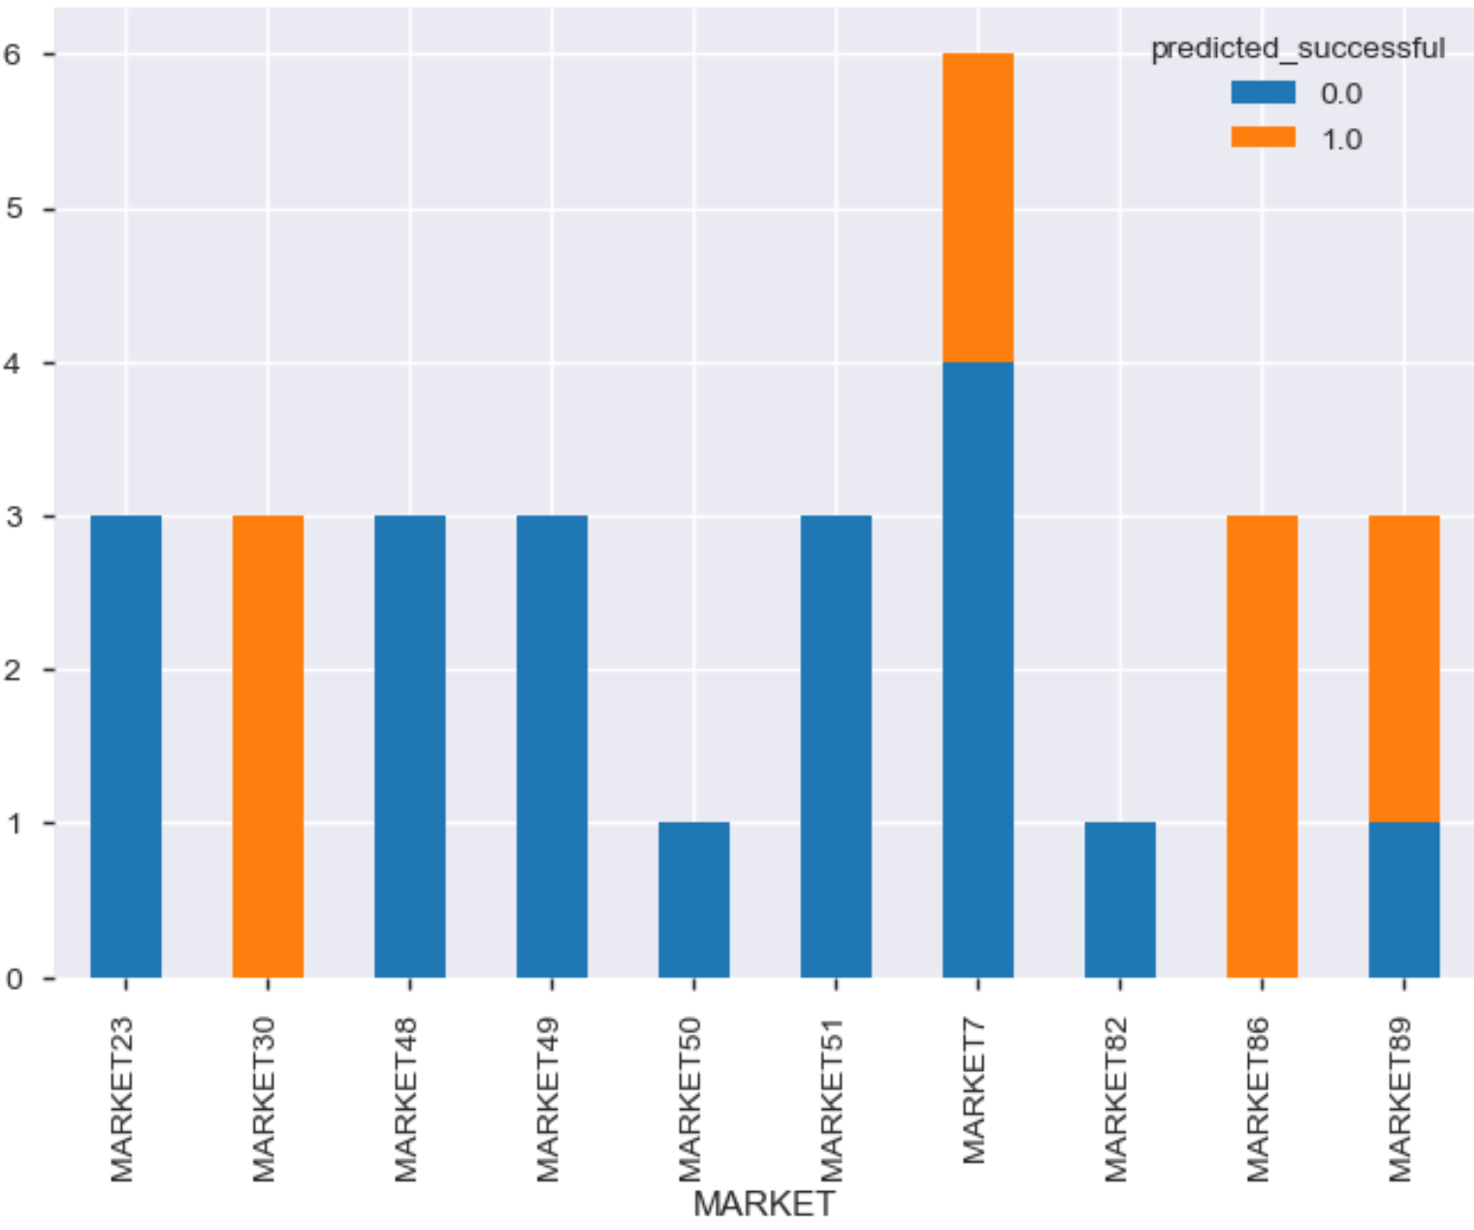
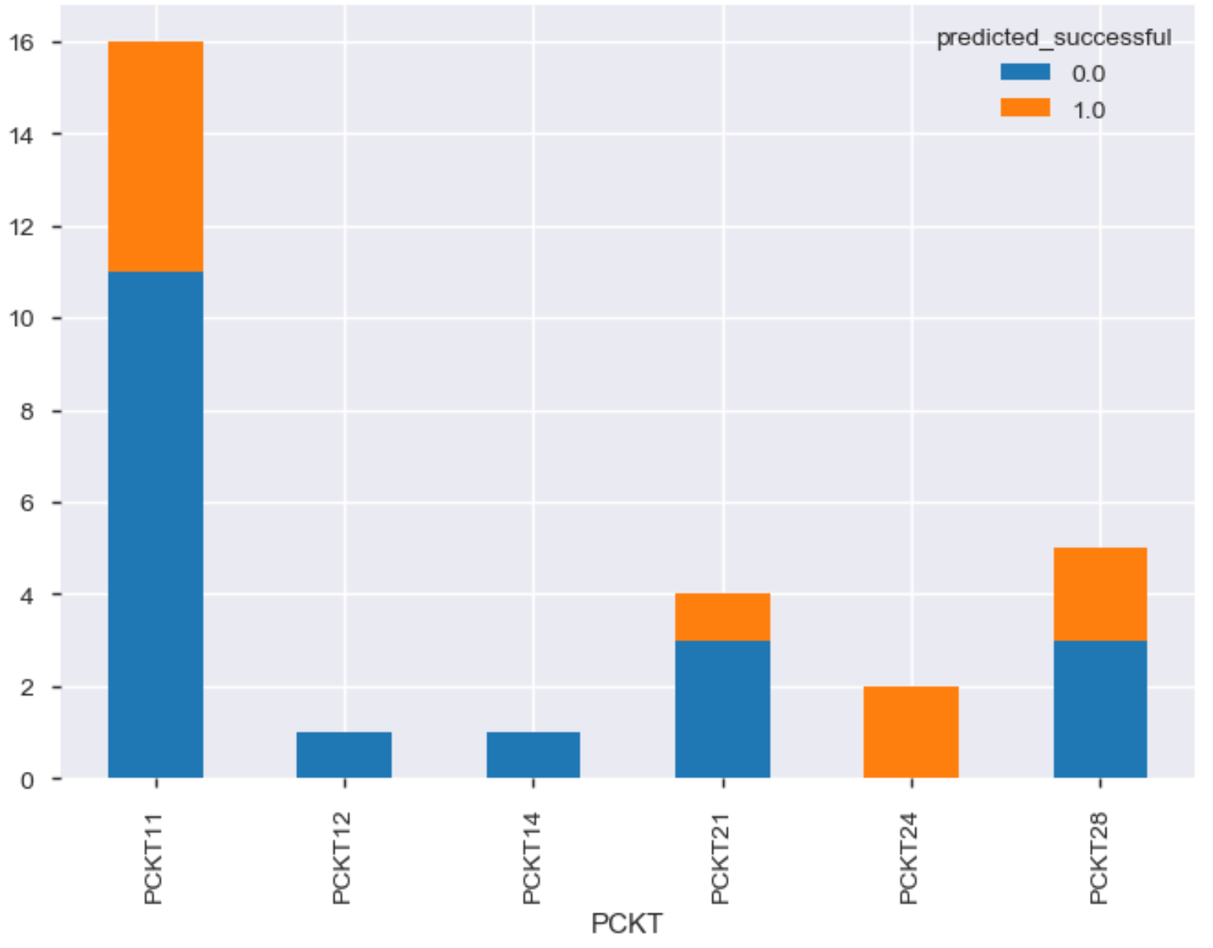
PREDICTIONS TRENDS
Market predicted successful
Pckt predicted successful
Packet also shows an interesting pattern
Success seems to be tied with the market

Slide 13
NEXT STEPS
Data Preparation
Get actual business understanding and more data
Additional feature selection approaches (permutation based, rfe, …)
More feature transformations (normalization, …)
Missing data imputation (mean, median, …)
Additional balancing techniques (smote, rose, …)
Play with the 0.07% threshold so it can generate more balanced dataset
Modeling
Apply more regularization to prevent overfitting
Use validation sets
Cost sensitive learning (use sample weight in the loss function)
Additional algorithms
Ensembling
Deeper model interpretation (Lime, Shapley, partial dependencies)
Creation and use of validation datasets (didn’t do because of amount of data)
Additional data sources :
Smarter stratification
demographic, economic and public information

Slide 14

Thank you!

Slide 15
Data preparation
Data type conversions
Launch date converted to year, quarter and month
List of hard removals
BRMID: Looks like an ID
NPLLAUNCHDATE, NPLLAUNCHYEAR: These can be removed because two derived features are based on it
NPLLAUNCHYEAR: The derived feature is more useful than this
BLDIMAGE: It's almost entirely a single image
LEN: We will use LENCATEGORY, we don't need both
Variable cardinality (high unique%)
BRANDONMARKET, MARKETEDBRAND, ISREPLACEMENT, LATESTPERIODINDEX
Variable population (high missing%)
RTYPE, ITEMSHAPE, SPECIALFLAVOR, TIPCOLOR

